Slide 1

Working with People in Residential Settings
Presented by: Elizabeth Adams, M.Ed., Training Coordinator

Slide 2
Housekeeping--Virtual
Please do not share identifying information about the people with whom you work.
Please turn on your camera and mute your microphone.
At the conclusion of the training you will receive an email with the link for the quiz.
Be sure to give a copy of your certificate to your supervisor and save a copy for your files.

Slide 3
Housekeeping—in-person
Please do not share identifying information about the people with whom you work
Please turn off phone or place on silent
Be sure to sign in with your name and email in order to get your certificate
Before you leave today be sure to complete the quiz and the evaluation

Slide 4
Learning Objectives
Learn
Learn the characteristics of mental health and developmental issues
Review
Review the history of care models and the value of community integration
Explore
Explore the role of the direct care staff as effective teacher of skills
Understand
Understand of the impact of language, judgment, and expectations
Clarify
Clarify best practices of documentation and record-keeping

Slide 5
The People We Serve

Slide 6
Dimensions of Disabilities
The World Health Organization (2001) describes the three dimensions of a disability as:
Impairment in a person’s body structure/function, or mental functioning (Example: loss of a limb, loss of vision or memory loss)
Activity limitation, such as difficulty seeing, hearing, walking, or problem solving
Participation restrictions in normal daily activities such as employment, engaging in social/recreational activities, and obtaining health care and preventative services

Slide 7
caused by a mental or physical problem or both
becomes a problem before the age of 22
is likely to continue for a very long time
requires special treatment for a long time, often over one’s lifetime
Characteristics of Developmental Disability

Slide 8
Developmental disabilities can result in major limitations in the ability to:
Talk or express oneself and understand and follow simple directions
Take care of oneself in daily living activities, such as dressing and toileting
Learn to recognize colors, shapes, letters, words, and foods
Move in a normal manner that includes walking, running, and sitting
Make decisions or do what is needed to take care of oneself
Live independently
Earn money and partially support oneself

Slide 9
Causes of Developmental Disabilities
injury
prenatal events
poor nutrition
exposure to toxins
genetic abnormalities
physical deformities
diseases of the mother during pregnancy (Rubella, syphilis, meningitis)
early childhood illness (measles)

Slide 10
Developmental Disabilities
Down Syndrome—chromosomal abnormality
Seizure disorders—including epilepsy
Cerebral palsy—movement and posture disorder
Autism spectrum disorders—disorder of communication and social interaction

Slide 11
Significantly impairs judgment and behavior
May affect one’s capacity to recognize reality
Interferes with the ability to cope with the ordinary demands of life
Mental illness is a substantial disorder of thought or mood

Slide 12
Diagnosis:
by a professional using standardized assessment tools
Treatment:
a range of therapeutic techniques, medication, behavioral interventions
Psychotic disorders—distortion of reality
Affective disorders—mood impairment
Anxiety disorders—disruptive fears and tensions
Personality disorders—dysfunctional patterns of thinking and behaving

Slide 13

Evaluation and diagnosis must be made by a professional, and is meant to inform rather than limit

Slide 14
Isolation and segregation vs. community integration

Slide 15

Institutions as limiting environments:
don’t provide chances for people to learn or try out new behaviors
don’t allow people to make decisions about their lives
don’t allow people to learn independent living skills
don’t encourage people to take responsibility for themselves and their own needs and care

Slide 16
Community integration
Provides role models for and opportunities to practice daily living activities, emotional regulation, social interaction, and cooperative living skills
Reduces prejudice and stigma by allowing other members of the community opportunities for interaction with the person with disabilities

Slide 17
Increase a person’s control over her/his environment
Build on a person’s strengths and abilities
Goals of Active Treatment
Active treatment means watching for and using every chance to teach people new skills and behaviors that can allow them to take control of their lives and lead to independence
When you assist people in living their own lives, you become a teacher, not a caretaker

Slide 18
segregation--reinforces the false notion that those who are segregated NEED to be segregated
your public interactions with the people in your care--when you are controlling, negative, parental, age-inappropriate, or disrespectful while in your professional role you are normalizing that mistreatment
language--using words like “crazy”, “demented”, “retarded”, etc… contributes to the negative representation
How are stereotypes and prejudices reinforced?

Slide 19
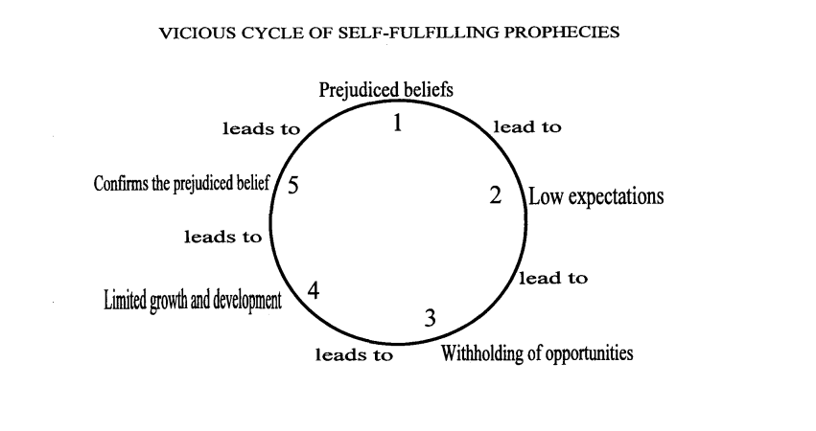

Slide 20
3 Myths about Developmental Disabilities
People who have a developmental disability can not learn.
  FALSE: Individuals with a developmental disability are able to learn new information and skills. The limitation can be reduced by teaching skills in a way that helps the individual function at their maximum potential.
People who have a developmental disability need constant special care.
  FALSE: individuals with a developmental disability may need more supervision/assistance, but do not always require constant care.
People who have a developmental disability are dangerous.
  FALSE: those with a developmental disability are just as likely as someone without a developmental disability to be dangerous.

Slide 21
3 Myths about Mental Illness
All individuals with mental illness are the same.
  FALSE: each person with or without a mental illness is a unique person with their own likes, dislikes, and personality.
The media portrays an accurate picture of individuals with mental health disorders.
  FALSE: the media portrays those with mental illness as being dangerous, hopeless, or helpless victims.
The biggest problem individuals face with mental illness as they move into the community is their illness.
  FALSE: the biggest problem facing individuals with mental illness is not being accepted by others.

Slide 22
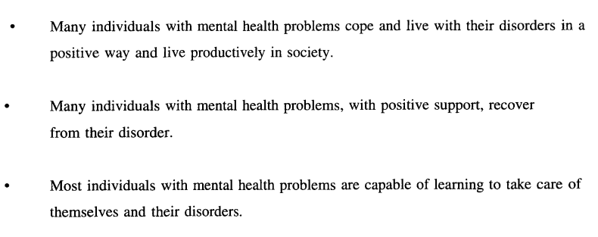

Slide 23
Person-First Language
Instead of: | Say:
“handicapped person” | “Person with disability”
“retarded” | “Person with an intellectual disability”
“bipolar person” | “A person who has bipolar disorder”

Slide 24
The roles and responsibilities of a direct care provider

Slide 25
Flexibility
Openness
Courage
Compassion
Curiosity
Patience
Qualities required of a caregiver

Slide 26
Your role as teacher
A shift in thinking—from correction and control to guidance and support
Differences in preferences and performance should be supported and not necessarily targeted for change
Skills develop when a person has an opportunity to participate in a task or situation
ALL people learn through making a series of mistakes that are effectively corrected by the person responsible for teaching
The direction toward growth and independence is in taking risks to learn more complex tasks
Because one does not initiate action does not mean they are unable to do that skill

Slide 27
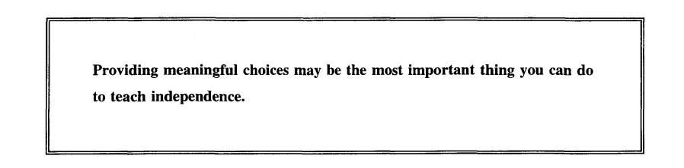

Slide 28
Tasks should never be done for or to a person
Avoid using excessive verbal prompts
Do the task with the person, reducing the social distance and modeling the task
Tasks should be meaningful and expectations should be fair
Breaking the task into smaller pieces allows for more opportunities for success
Be ready to reward any and all efforts by the person to participate in steps of the task
Make the focus the interaction rather than the task

Slide 29
Behavior as communication
People with disabilities may be less able to convey their wants, needs and feelings to those around them. They often use behavior to make up for their lack of verbal abilities.
Behaviors ALWAYS represent an attempt to communicate a need or want.
One of your roles as a direct care worker is to pay attention to this behavior- especially when there is a lack of verbal communication.
Give positive, constructive, consistent responses to individuals’ communication.
Remember: ALL BEHAVIOR IS COMMUNICATION!

Slide 30
To help a person make changes…
Communicate that it is ok to make mistakes
Provide a chance to practice change in a low-risk setting
Be patient
Help the person see how the change will affect them
Give regular feedback and encouragement
Give the person room to change in their own way and at their own pace

Slide 31
Teaching Techniques
You are required to treat those with whom you work with dignity and respect always, and under all circumstances.
If a technique cannot be used in a public setting, then the technique should not be used in the privacy of their home.

Slide 32
--having awareness of your body language and facial expressions
--recognizing the individual
--speaking up on behalf of those in your care
--monitoring your conversation with co-workers
--honoring confidentiality
--respecting privacy
--creating/maintaining a clean and safe environment
--paying attention
--showing unconditional positive regard
--attending to physical and emotional needs
--checking your tone of voice
How are you showing respect?

Slide 33
remember that you are in a person’s home
your role is not ‘parent’ or ‘therapist’
avoid sharing personal information
the person in your care should not be used to meet your needs
Boundaries

Slide 34
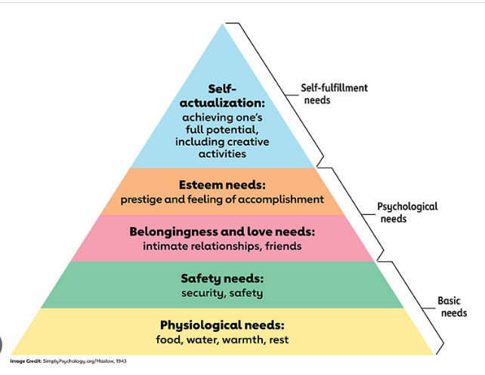
Maslow’s Hierarchy of Needs…
a quick review

Slide 35
Need for comfortable space or privacy, or freedom from unwanted intrusion.
Need to be able to talk to another person, or to feel the other person is listening and trying to understand what you are saying.
Freedom from insults, shaming by others, stigma, humiliation.
Freedom from physical and psychological threats or abuse.
Need to be able to feel safe and secure in the presence of those who provide you personal care.
Need to make your own decisions and to have control over your own life.
Freedom to move at one’s own pace, and to not be rushed or hurried by others.
Need to retain personal items and identifying materials.
Freedom from physical and emotional pain, hunger, thirst, excessive heat or cold.
Need to be aware of surroundings and free from confusion about what is happening.
Those things we take for granted…and that we should enable for those in our care

Slide 36
Please remember
Residents don’t live in our workplace…
…we work in their home

Slide 37

Documentation

Slide 38
Recordkeeping
Each home must have a recordkeeping system
-- to communicate with other staff or those involved in care
-- to support consistency and continuity of care
-- to serve as a means for data collection, which shows progress or lack of progress on goals and objectives
The method for record keeping may vary, but all individual records must include:
  Changes in the person-centered plan
  Changes in the person’s physical and mental health
  Any unusual events involving the person-served
  Information needed by other caregivers

Slide 39
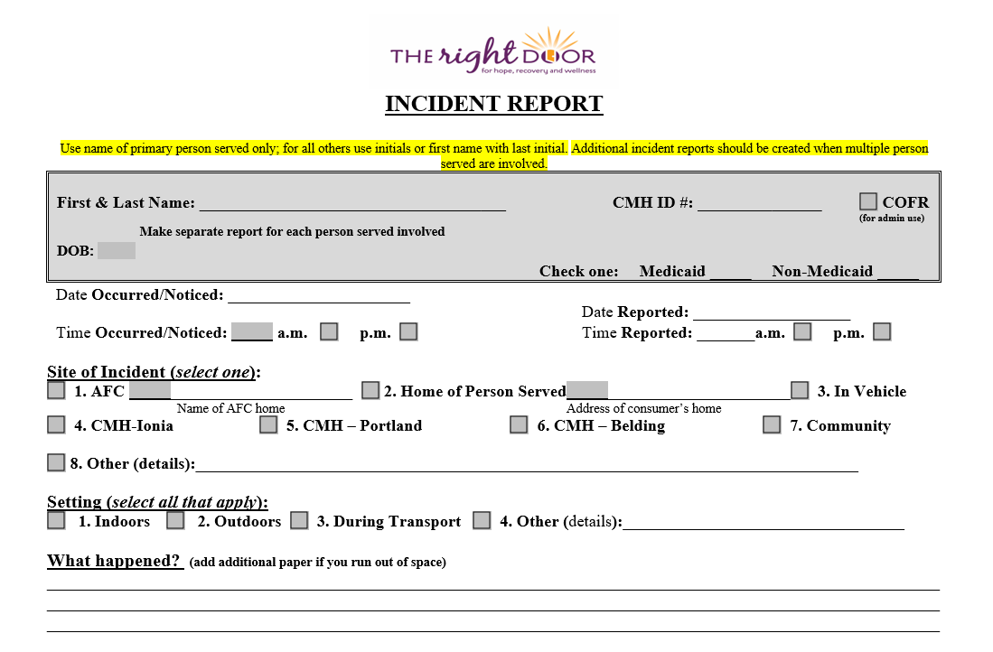
Incident Reports
Must be submitted within 24 hours

Slide 40
Do | Don't
Describe the events in order in which they occurred. Use the person’s legal name. Only use approved abbreviations or write out the word. Sign your first and last name. Draw a line through errors. Above the error, write “error” with your initials and the date. Make sure your handwriting is legible!! Be descriptive vs. evaluative. Write as if every document could be shared in court. | Use nicknames of the person- initials are preferred. Postpone documentation; documentation MUST take place daily and every shift. Use unapproved abbreviations. Falsify records. Complete documentation for another staff. Make judgments/assessments outside of your scope. Attempt to interpret or describe a person’s thoughts or feelings unless they were shared with you by that person. Violate the privacy of others in your reporting.
Documentation do’s and don’t’s

Slide 41
Service Log Instructions
For Personal Care/Community Living Support
In Specialized Residential Settings

Slide 42
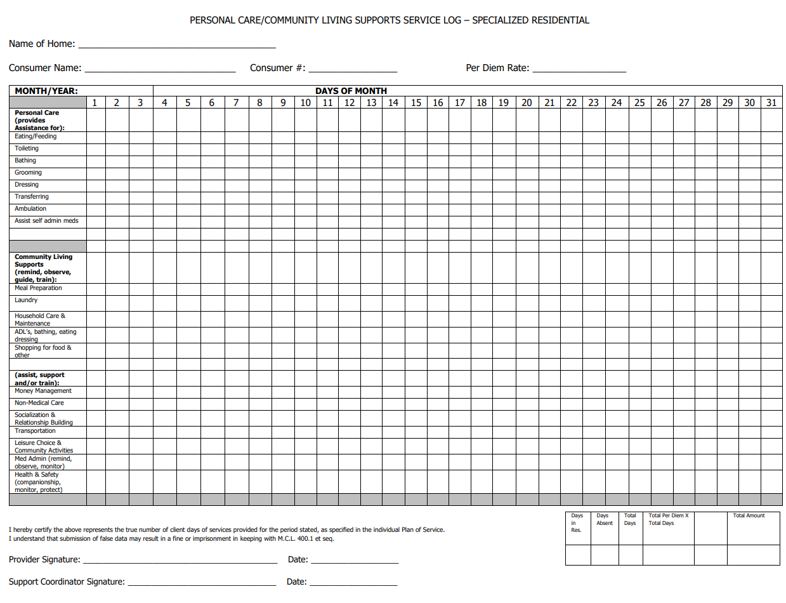
Overview

Slide 43
name of home
consumer name
month/year

Slide 44
Initial appropriate box for a service ONLY when it has been provided

Slide 45
The box must be initialed…
…by the staff person who provided the service

Slide 46
This is to be completed ON A DAILY BASIS

Slide 47
Checking every box and making copies of the form to be used again is considered Medicaid fraud and could result in legal/financial consequences for you and/or your facility.

Slide 48
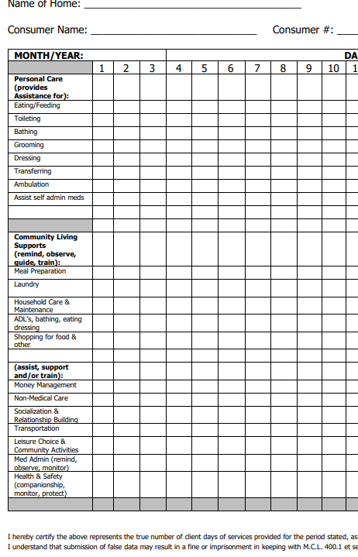
LOA
1. note clearly on the date of the absence
2. note reason for LOA
LOA--hospital

Slide 49
Form must be signed and dated in order to receive payment for services
provider signature
date

Slide 50
Summary Box
--days in residence
--days absent
--total days
--total per diem X total days
--TOTAL AMOUNT

Slide 51
Frequently Asked Questions
Q: Who should initial the boxes for services on this form?
A: The staff person who provided the service should initial the boxes.
Q: Does every box need to be initialed in order to receive payment?
A: Boxes should only be initialed if that service was provided.
Q: When should the form be completed?
A: The form should be completed DAILY.
Q: When should the form be submitted?
A: Within 5 days of the end of the month.

Slide 52
Form must be submitted within 5 days after completion of the month in which the services were rendered.

Slide 53
Questions: contact Linda McNett,
Contract Manager, The Right Door
lmcnett@rightdoor.org or 616-902-4432

Slide 54
To complete this training and receive your certificate, please send an email to this address with the subject line: WWP quiz
eadams@rightdoor.org
This step is required in order to get the link to the quiz.

Slide 55

Take the quiz
Complete the evaluation
Make sure your information is correct on the sign-in sheet

